Slide 1
430.211 Programming Methodology (프로그래밍 방법론)
Taesup Moon
Department of Electrical and Computer Engineering
Seoul National University

Slide 2
Outline
Intro & Basic course info
Chapter 1: C++ Basics
Programming paradigm
Comparison between C, C++ and Python
Simple C++ program

Slide 3
Outline
Intro & Basic course info
Chapter 1: C++ Basics
Programming paradigm
Comparison between C, C++ and Python
Simple C++ program

Slide 4
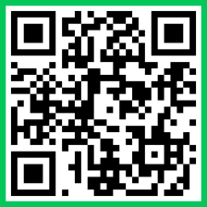
Intro & Basic course info
Basic survey
https://forms.gle/rqUFeQks36pkJvzQ7
Please do it right now with your phone or laptop!

Slide 5
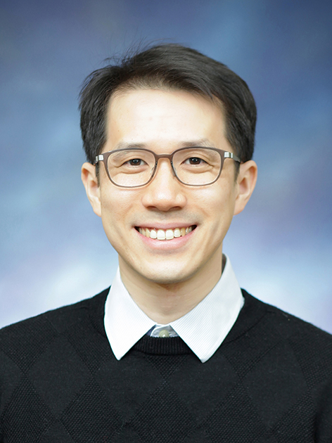
Intro & Basic course info
Instructor: Taesup Moon (문태섭)
Rm 301-707, tsmoon@snu.ac.kr
Office Hour: By appointment
Brief Intro
Where I have been to so far
SNU EE BS ‘02
Stanford EE MS (‘04) / PhD (‘08)
Yahoo! (‘08-’12) / UC Berkeley STAT (‘12-’13) / Samsung (‘13-’15)
DGIST (‘15-’17) / SKKU (‘17-’21) / SNU (’21.3-Today)
Main research area: ML / AI / Data Science

Slide 6
Intro & Basic course info
Lab1 TAs
Yongho Kim (김용호, peterkim98@snu.ac.kr)
JuhyunPark (박주현, parkjh9229@snu.ac.kr)
Jung Yoon Hwang (황정윤, danieljyh@snu.ac.kr)
Lab2 TAs
Heewoong Choi (최희웅, chw0501@snu.ac.kr)
Sumin Yu (유수민, ysmsoomin@snu.ac.kr)
Hyunwoong Bae (배현웅, hwbae0326@snu.ac.kr)
eTL & 엘리스(elice) is the main communication channel
You can also e-mail the instructor and TAs

Slide 7
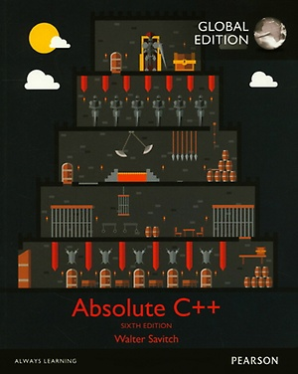
Lectures and Lab Sessions
Lectures (Wed, 15:30pm-17:20pm) by the Instructor
English lectures
Textbook: Absolute C++ (6th or 5th edition)
By Walter Savitch and Kenrick Mock
English version or 한글 번역본 (by 퍼스트북).
Pdf version uploaded to eTL
Lab1 (Fri, 15:30pm-17:20pm) by the TAs (Head: 김용호)
Lecture review, problem solving, HW solution/review
Lab2 (Fri, 15:30pm-17:20pm) by the TAs (Head: 최희웅)
Linux, C++ applications/STL, Git, In-depth Projects,

Slide 8
Grading policy
Homework (20%)
Lab1 (10%), Lab2 (10%)
Projects (22%)
Project 1 (10%), Project 2 (12%)
Midterm Exam (22%)
October 22, 3:30pm (tentative)
Final Exam (31%)
December 17, 3:30pm (tentative)
Attendance (5%)
Participation Bonus (more on this)

Slide 9

Grading policy - Homework
HW will be handed out every week from Lab1/2
All HW must be done individually
Copy & Plagiarism
Strictly prohibited
Integrity is more important than a grade!
University/academia is a place for ladies and gentlemen.
When copying is caught, both students who showed and copied will get F grades (Do not make innocent victims!)
Discussing together about HW and projects is okay, but you need to code individually!

Slide 10
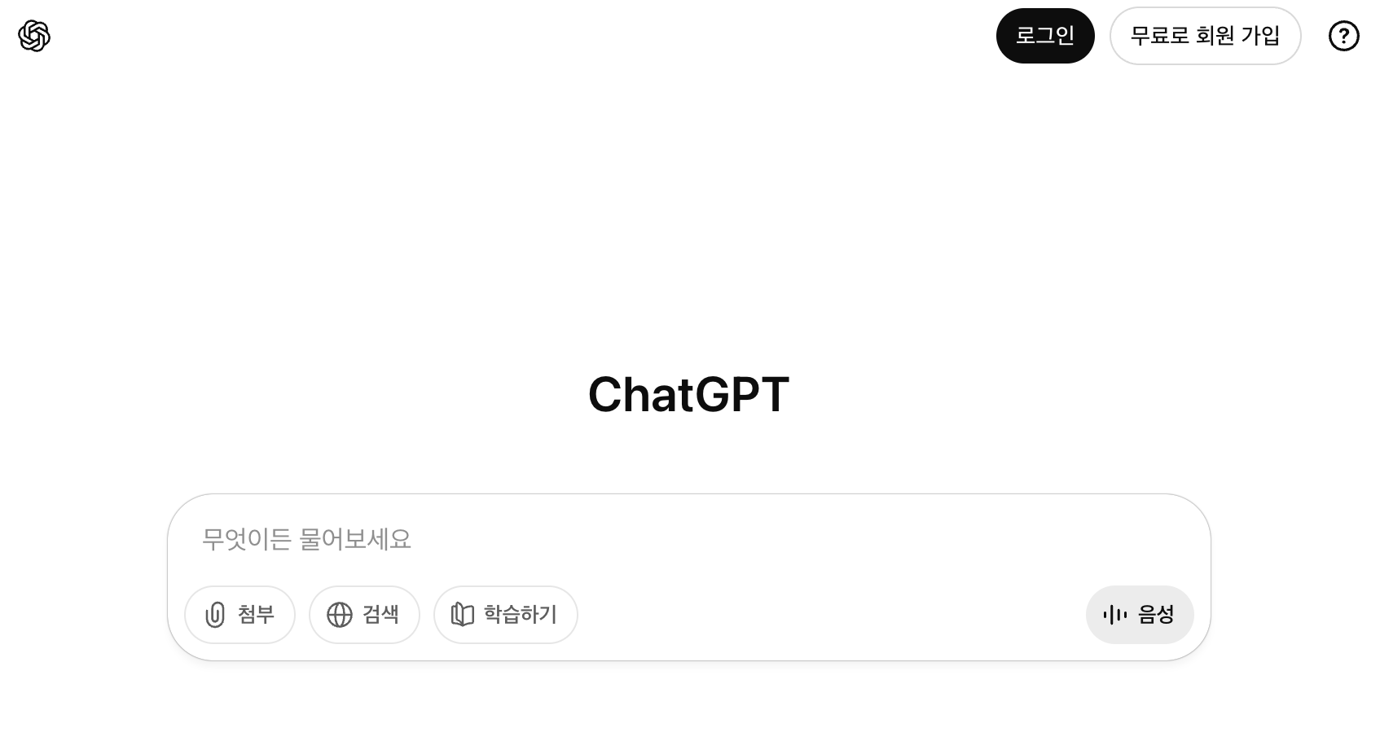
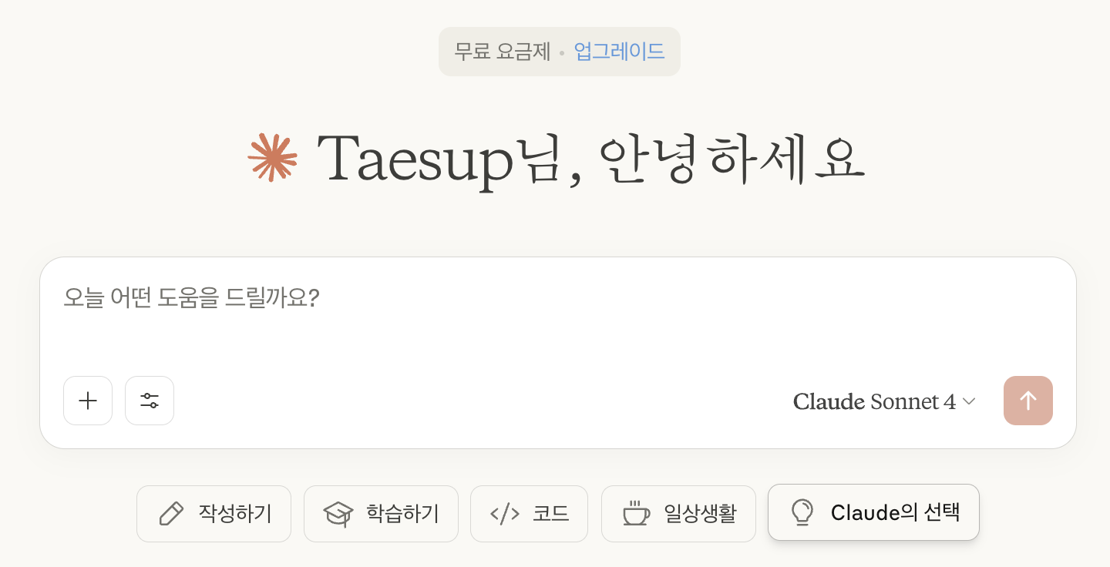
Grading policy - Homework
AI tools (ChatGPT, Claude, Gemini, … etc)
Two sides of a sword (beneficial vs. harmful)
Actively using ChatGPT for generating answers for the HW is regarded as a plagiarism!
In fact, it makes us think deeply about the future of programming itself…
HWs are for improving your skills / understanding about programming, not for your grade!

Slide 11
Grading policy - Projects
There will be 2 projects
Project 1: TBD (week 8)
Project 2: TBD (week 12)
Each project will have 3~4 weeks to work on
More details will be given in Lab2 sessions
Projects will be more challenging than past years (due to AI tools)
Team of 2
Some final questions will be about projects

Slide 12
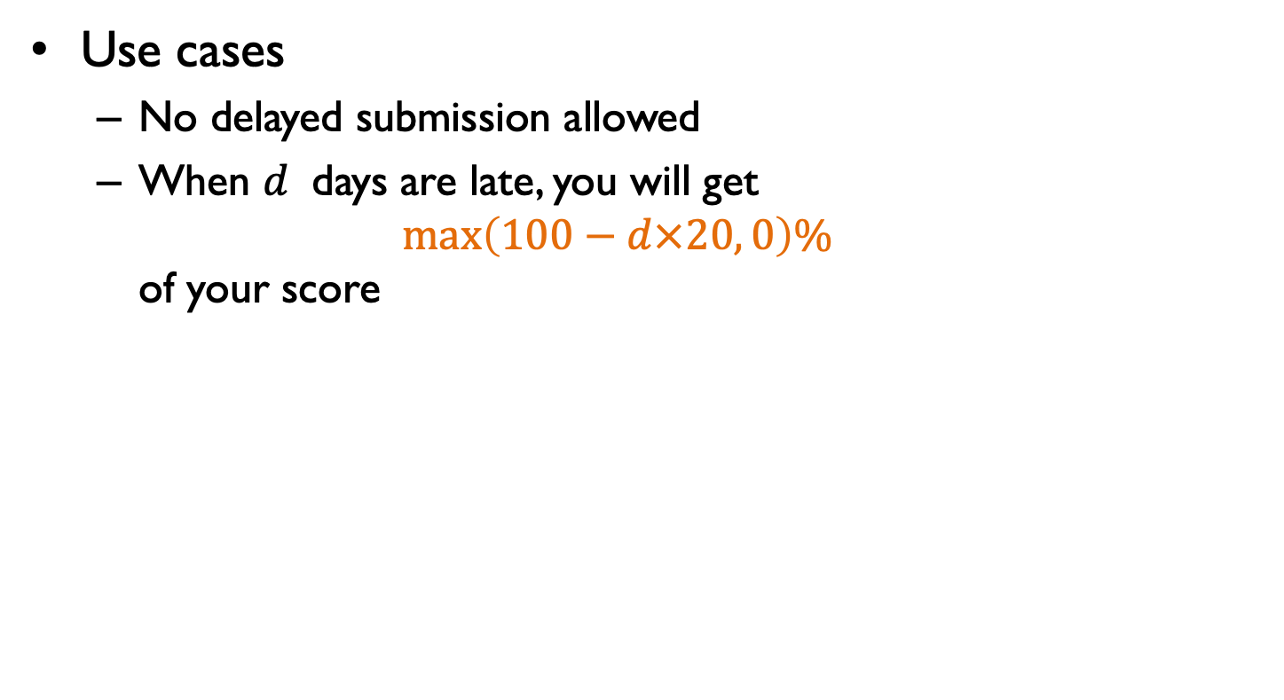
Grading policy – Delay
Use cases
No delayed submission allowed
When $d$ days are late, you will get $max\left(100−d×20, 0\right)\%$ of your score

Slide 13
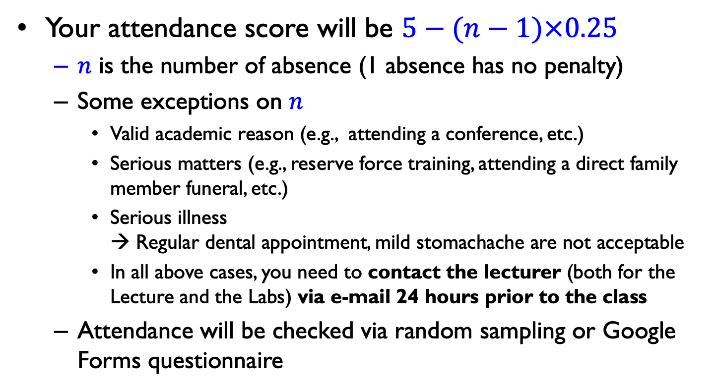
Grading policy - Attendance
Your attendance score will be $5−(n−1)×0.25$
$n$ is the number of absence (1 absence has no penalty)
Some exceptions on $n$
Valid academic reason (e.g., attending a conference, etc.)
Serious matters (e.g., reserve force training, attending a direct family member funeral, etc.)
Serious illness → Regular dental appointment, mild stomachache are not acceptable
In all above cases, you need to contact the lecturer (both for the Lecture and the Labs) via e-mail 24 hours prior to the class
Attendance will be checked via random sampling or Google Forms questionnaire

Slide 14
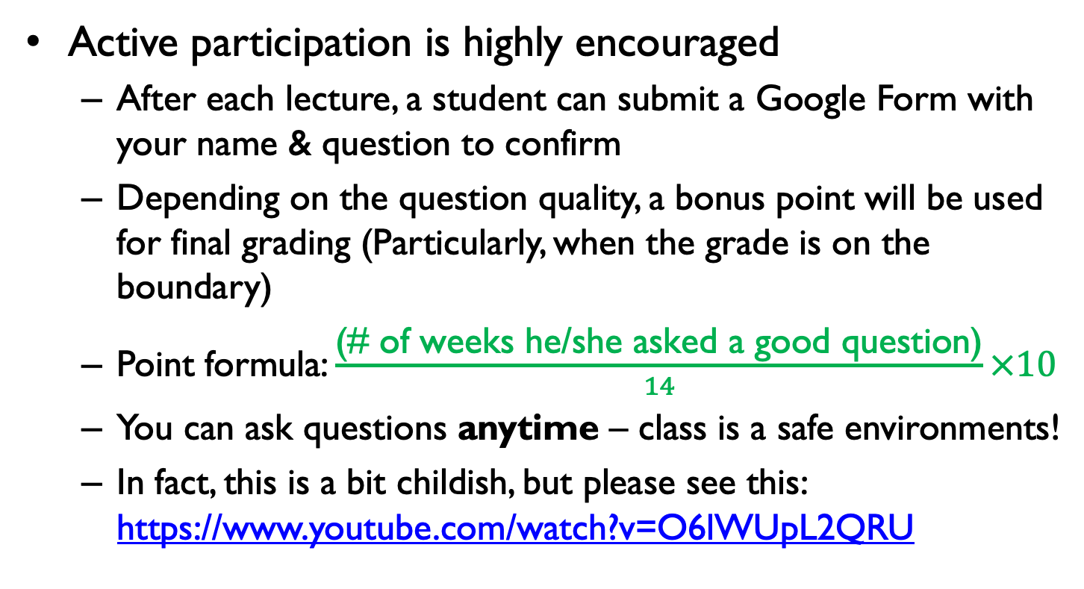
Grading policy - Participation
Active participation is highly encouraged
After each lecture, a student can submit a Google Form with your name & question to confirm
Depending on the question quality, a bonus point will be used for final grading (Particularly, when the grade is on the boundary)
Point formula: $\frac{\text{(\# }\text{of} \text{weeks} \text{he}\text{/}\text{she} \text{asked} \text{a} \text{good} \text{question}\text{)}}{14}×10$
You can ask questions anytime – class is a safe environments!
In fact, this is a bit childish, but please see this: https://www.youtube.com/watch?v=O6lWUpL2QRU

Slide 15
Prerequisites and Emphasis
Prerequisites
Basic computer skills
Knowledge/experience of high-level programming languages, e.g., Python
Emphasis
Concepts and programming practices of the Object-Oriented Programming (OOP) paradigm
Experience of C++ programming skills

Slide 16
Schedule for Lecture/Lab1
Week | Contents | Week | Contents
1 (9/3) | Introduction, C++ Basics (Ch.1) | 9 (10/29) | Operator Overloading, Friends, and References (Ch.8-1)
2 (9/10) | Flow of Control (Ch.2) | 10 (11/5) | Friends, and References (Ch.8-2) Strings (Ch.9),
3 (9/17) | Functions (Ch.3) | 11 (11/12) | Pointers and Dynamic Arrays (Ch.10)
4 (9/24) | Parameters and Overloading (Ch.4) | 12 (11/19) | Namespaces (Ch.11)
5 (10/1) | Arrays (Ch.5) Structures and Classes (Ch.6) | 13 (11/26) | Inheritance (Ch.12)
6 (10/8) | No Class | 14 (12/3) | Virtual Functions (Ch.13)
7 (10/15) | Constructors and Other Tools (Ch.7) | 15 (12/10) | Templates (Ch.14)
8 (10/22) | Midterm Exam | 16 (12/17) | Final Exam

Slide 17
Schedule for Lab2
Week | Contents | Week | Contents
1 (9/1) | Linux– Pt. 1 | 9 (10/27) | No class
2 (9/8) | Sorting Algorithm– Pt. 1 | 10 (11/3) | Standard Template Library – Pt. 3
3 (9/15) | Sorting Algorithm– Pt. 2 | 11 (11/10) | Standard Template Library – Pt. 4
4 (9/22) | Version control system (Git) – Pt. 1 | 12 (11/17) | Project 2
5 (9/29) | Version control system (Git) – Pt. 2 | 13 (11/24) | Linux– Pt. 2
6 (10/6) | Make-Up Video Lecture (No Class) Standard Template Library – Pt. 1 | 14 (12/1) | Problem Solving – Pt. 1
7 (10/13) | Standard Template Library – Pt. 2 | 15 (12/8) | Problem Solving – Pt. 2
8 (10/20) | Project 1 | 16 (12/15) | No class

Slide 18
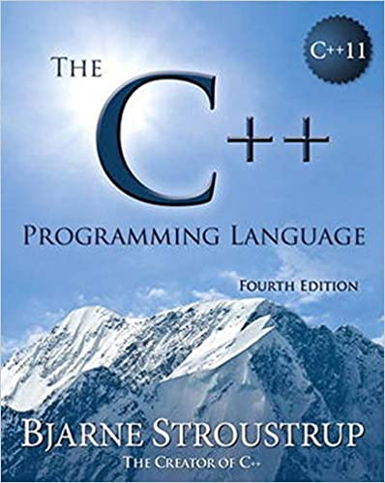
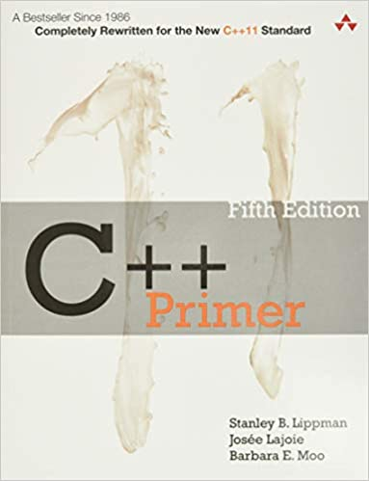
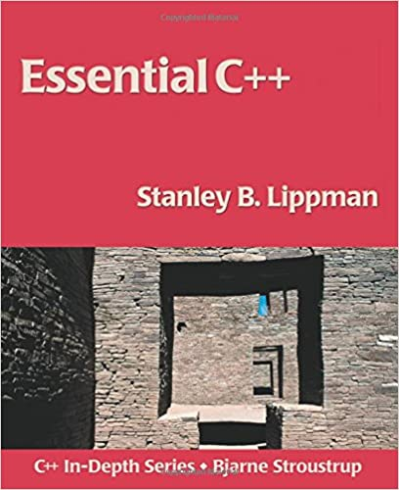
Other References
The C++ Programming Language
By Bjarne Stroustrup
C++ Primer
By Stanley B. Lippman et al.
Essential C++
By Stanley B. Lippman

Slide 19
Outline
Intro & Basic course info
Chapter 1: C++ Basics
Programming paradigm
Comparison between C, C++ and Python
Simple C++ program

Slide 20
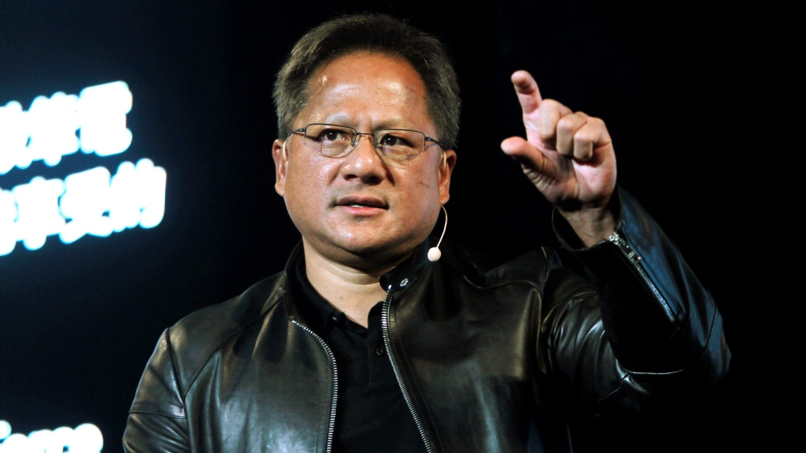
Before we begin…
A Controversy
Don’t learn to code, but study biology!
--- Jensen Huang, Feb 2024
???

Slide 21
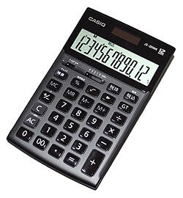
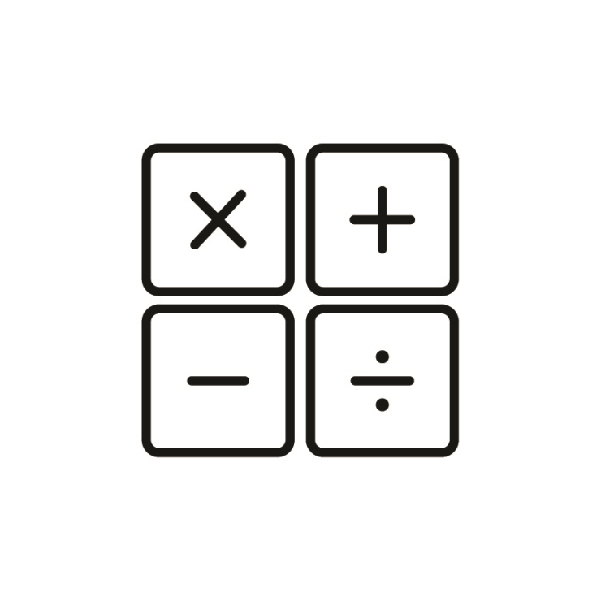
Before we begin…
A Controversy
Do we need to learn arithmetic despite the calculator?
Yes!

Slide 22
Before we begin…
Computational thinking & coding should be still relevant
The paradigm may change.
But, we still need to learn, know & practice the basic
Useful read
https://www.oreilly.com/radar/the-end-of-programming-as-we-know-it/

Slide 23
Programming Paradigms
Low-level vs. high-level programming languages
Machine friendly vs. human friendly
Styles of computer programming
Procedural programming
Object-oriented programming
Functional programming
Logic programming
…

Slide 24
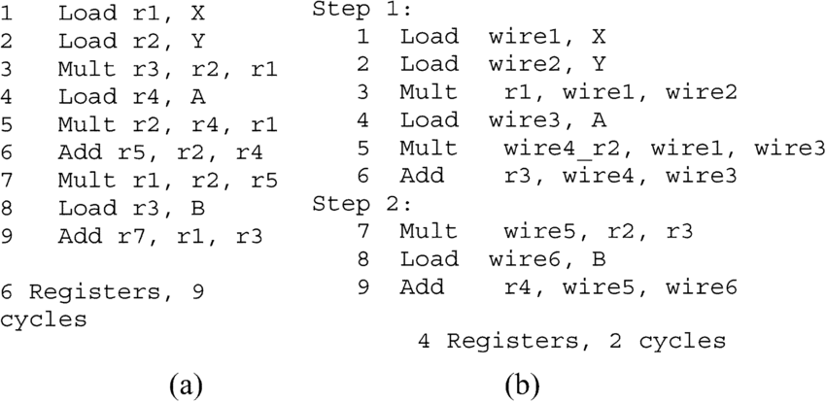
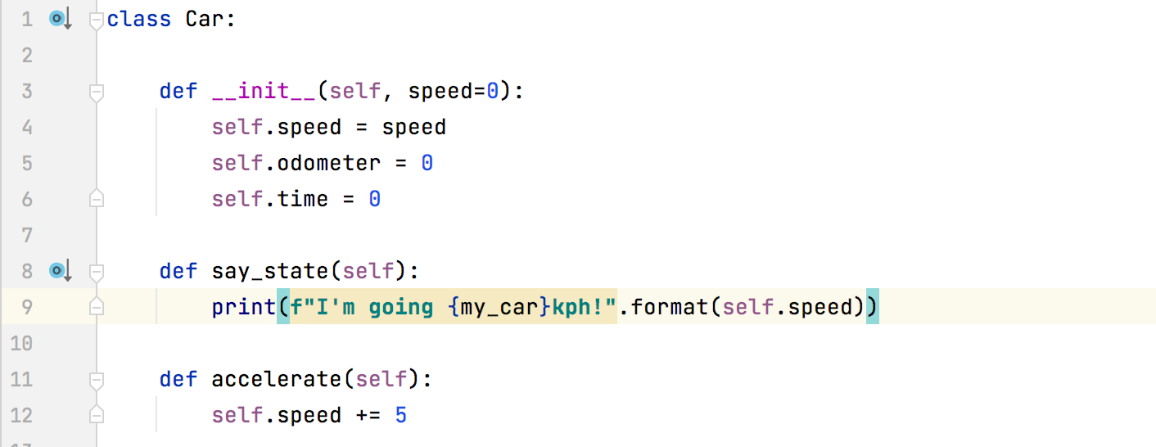
Low-level vs. High-level Programming
Low-level
Machine code
Assembly
High-level
Basic, C, Java, Pascal, C++, Python, Perl …

Slide 25
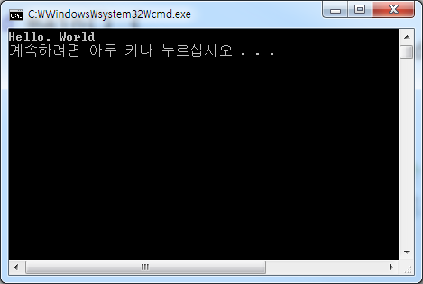
Comparison between C, C++ and Python : A Simple C Program
#include <stdio.h>
void main() {
printf(“Hello, World\n”);
}

Slide 26
Comparison between C, C++ and Python : A Simple C++ Program
#include <iostream>
void main() {
std::cout << “Hello, World” << std::endl;
}
C++ is an extension of C.
#include <stdio.h>
void main() {
printf(“Hello, World\n”);
}

Slide 27
Comparison between C, C++ and Python : Compile & Execute
Write or edit source code
Fix bugs that emerge during compilation
Compile source code
Fix bugs that emerge during execution
Link object code
Run program

Slide 28
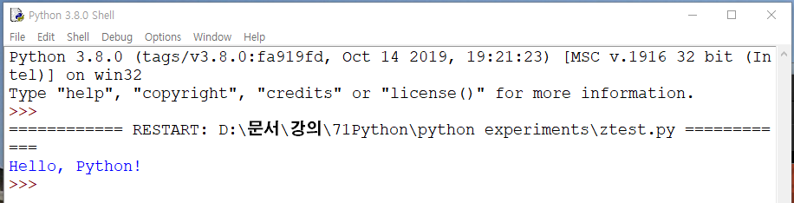
Comparison between C, C++ and Python : A Simple Python Program
print("Hello, Python!")

Slide 29
Comparison between C, C++ and Python : In Python Shell, Interpret Each Line…
Write a line
Interpret the line
>>> print("Hello, Python!")
>>> def f(a):
b = a + 1
print(b)
In this case, the line is long…

Slide 30
Comparison between C, C++ and Python : In Python IDLE, Check Syntax & Interpret
Write or edit source code
Fix syntax errors
Check syntax errors
Fix bugs that emerge during execution
Interpret line after line
def f(a):
b =+= a + 1
print(b)
f(3)
def f(a):
b = a + 1
print(b)
f(3)

Slide 31
Comparison between C, C++ and Python : In C++, Compile & Execute
Write or edit source code
Creates a.cpp, b.cpp,…
Fix bugs that emerge during compilation
Compile source code
Fix bugs that emerge during execution
Produces a.o, b.o,…
Link object code
Produces ab.exe
Run program
By double clicking ab.exe
Compiler vs. Interpreter
https://www.youtube.com/watch?v=Dx2tSsd3aFc
From a.py, Python does not produce any extra files.
Why?
It is because Python is an interpreted language.
C/C++ produces ab.exe (other than *.cpp) since it is a compiled language.

Slide 32
Styles of Computer Programming
Procedural programming (절차형 언어)
Imperative: procedures, routines, subroutines, methods, or functions.
E.g. Basic, C, Fortran…
Object-oriented programming (OOP, 객체지향 언어)
Currently popular and powerful programming technique
Main characteristics
Encapsulation (Information hiding or abstraction)
Inheritance (writing reusable code)
Polymorphism (a single name can have multiple meanings, etc.)
More on these later!

Slide 33
Why C++?
Improving C
C became popular with UNIX operating system
C has features of both high-level and low-level language
Can manipulate memory directly (low-level)
Easier to read and write than Assembly
But, it is not as easy as other high-level language
C++ has facilities for classes
Supports data abstraction, OOP, and generic programming
Has many users and wide applications
Many production codes are written in C++!

Slide 34
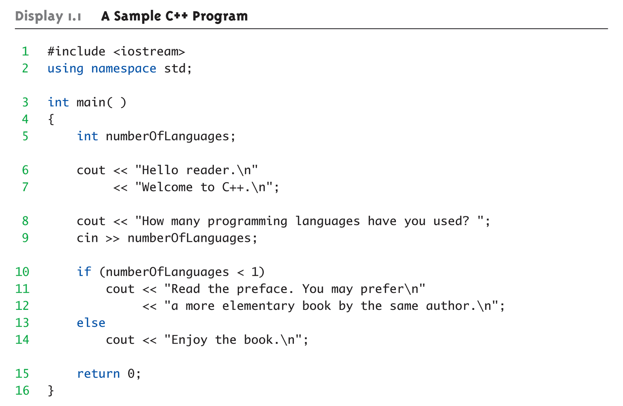
Display 1.1 A Sample C++ Program (1 of 2)

Slide 35
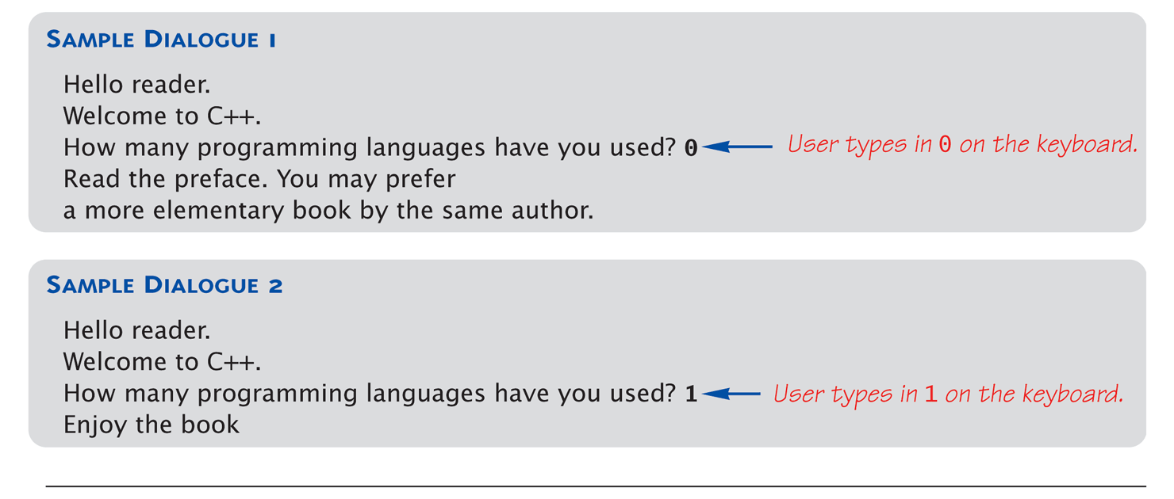
Display 1.1 A Sample C++ Program (2 of 2)

Slide 36
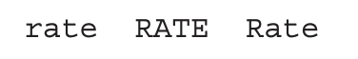
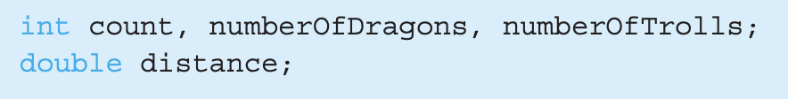
Variables
Identifiers
Keywords/reserved words
Case-sensitive
Illegal usages
Use meaningful names!
Variables
A memory location to store data for a program
Must declare all data before use in program

Slide 37
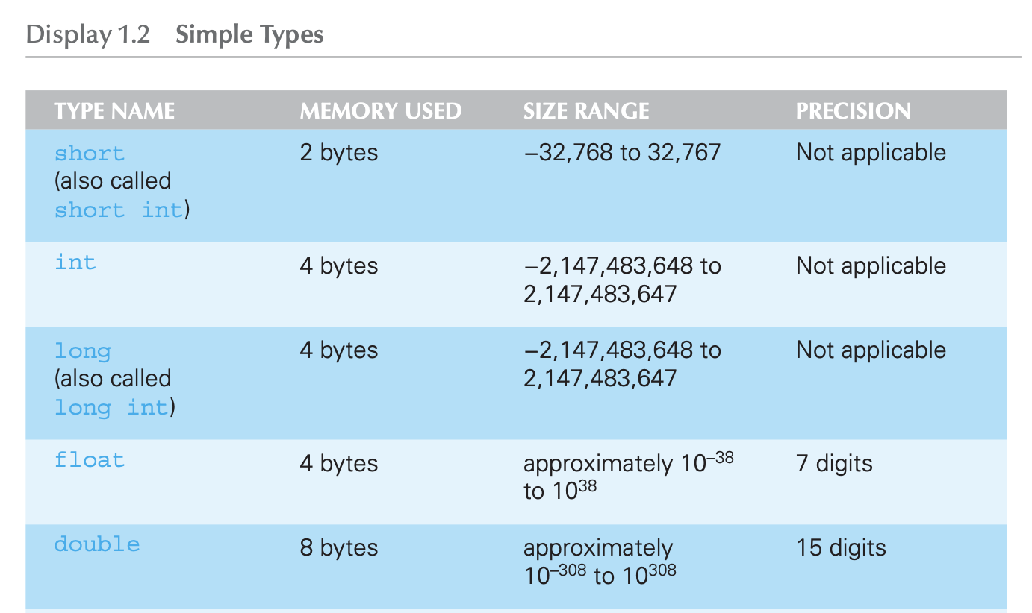
Data Types: Display 1.2 Simple Types (1 of 2)
Depends on the OS and targeted architectures

Slide 38
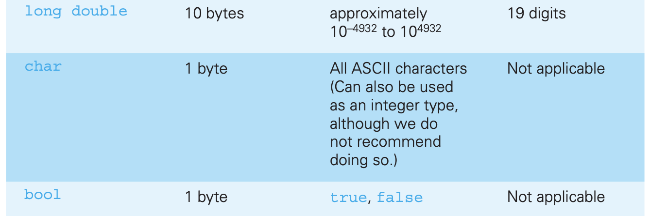
Data Types: Display 1.2 Simple Types (2 of 2)

Slide 39
Assignment Statements
Initializing data in declaration statement
Results "undefined" if you don’t initialize
int myValue = 0;
Assigning data during execution
Lvalues (left-side) & Rvalues (right-side)
Lvalues must be variables
Rvalues can be any expression
Example: distance = rate * time; Lvalue: "distance" Rvalue: "rate * time"

Slide 40
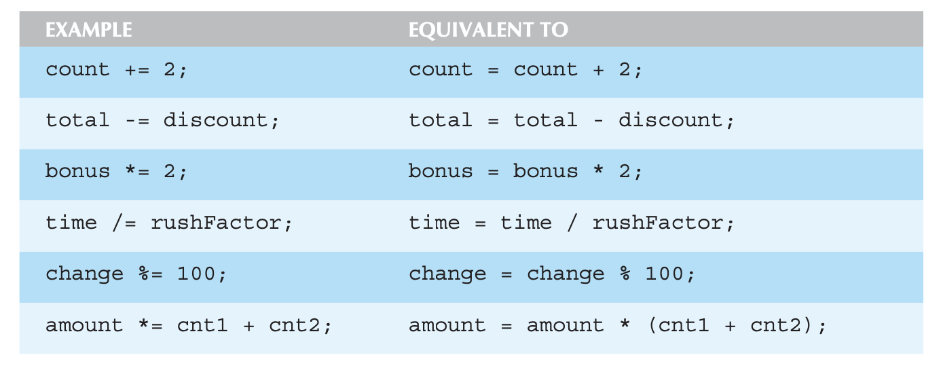
Assignment Statements : Shorthand Notations

Slide 41
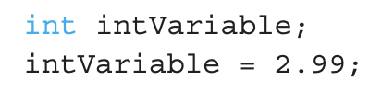
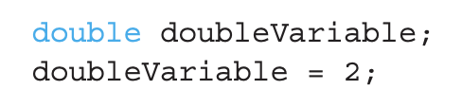
Assignment Rules / Compatibility
Data assignments should be compatible!
Generally, cannot place value of one type into a variable of another type!
Only integer part "fits", so that’s all that goes into the intVariable
Called "implicit" or "automatic type conversion"
Some special cases are allowed
Both legal and acceptable
Literals: considered “constants” (cannot be changed)
E.g.) 2, 5.75, ‘Z’, "Hello World"
Type mismatch!

Slide 42
Escape Sequences
"Extend" the character set
Backslash, \ preceding a character
Instructs compiler: a special "escape character" is coming
Following character treated as "escape sequence char"
See Display 1.3 in the next slide

Slide 43
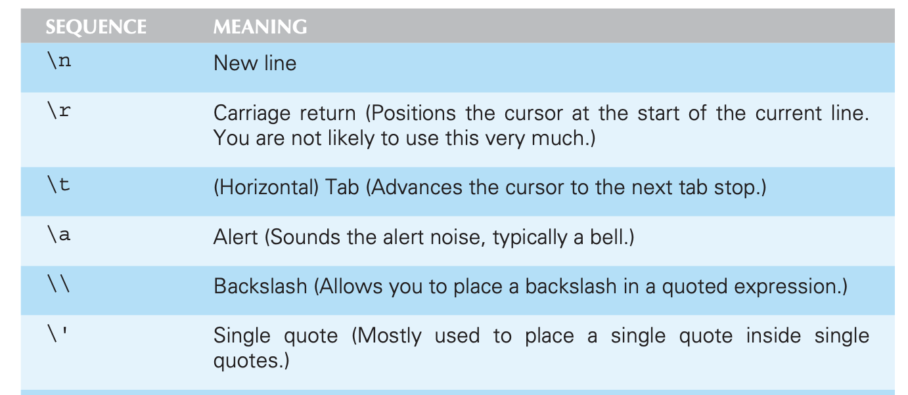
Display 1.3 Some Escape Sequences (1 of 2)

Slide 44
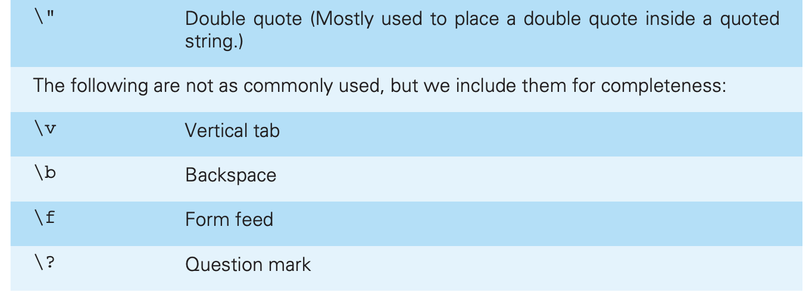
Display 1.3 Some Escape Sequences (2 of 2)

Slide 45
Arithmetic Precision
Precision of calculations
VERY important consideration!
Expressions in C++ might not evaluate as you’d "expect"!
"Highest-order operand" determines type of arithmetic "precision" performed

Slide 46
Arithmetic Precision : Examples
Examples:
17/5 evaluates to 3 in C++
Both operands are integers
Integer division is performed (note the number is NOT rounded.)
17.0/5 equals 3.4 in C++
Highest-order operand is "double type"
Double "precision" division is performed
int intVar1 =1, intVar2=2; intVar1/intVar2;
Performs integer division
Result: 0

Slide 47
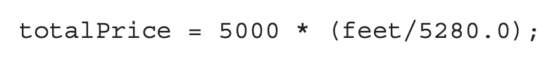
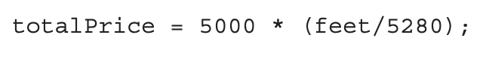
Arithmetic Precision : Examples
Examples:
When feet=15000 is an int type, evaluates to 5000*2.84=14200.
But, will become 5000*2 = 10000, which is a serious underestimate!

Slide 48
Individual Arithmetic Precision
Calculations are done "one-by-one"
1/2/3.0/4 performs 3 separate divisions.
1/2 equals 0
0/3.0 equals 0.0
0.0/4 equals 0.0
So not necessarily sufficient to change just "one operand" in a large expression
Must keep in mind all individual calculations that will be performed during evaluation

Slide 49
Type Casting (Type Conversion)
Two types
Implicit — also called as "Automatic"
Done FOR you automatically e.g., 17/5.5 causes an "implicit type cast" to take place, casting the 17 to 17.0
Explicit
Programmer specifies conversion with cast operator e.g., (double)17/5.5 is the same as above (explicit cast) (double)myInt/myDouble
A newer convention: static_cast<double>(m)

Slide 50
Shorthand Increment/Decrement Operators
Increment & Decrement Operators
Increment operator, ++ intVar++; is equivalent to intVar = intVar + 1;
Decrement operator, -- intVar--; is equivalent to intVar = intVar – 1;

Slide 51
Shorthand Operators: Two Options
Post-Increment intVar++
Uses current value of variable, THEN increments it
Pre-Increment ++intVar
Increments variable first, THEN uses new value

Slide 52
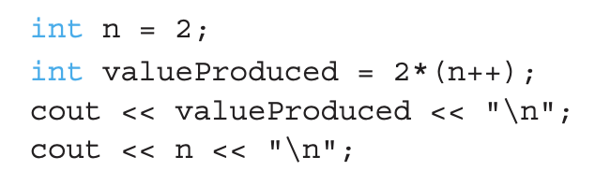
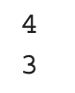
Post-Increment in Action
Post-Increment in expressions:
This code segment produces the output:

Slide 53
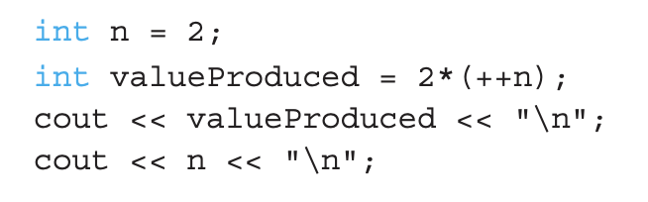
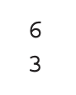
Pre-Increment in Action
Now using Pre-increment:
This code segment produces the output:

Slide 54
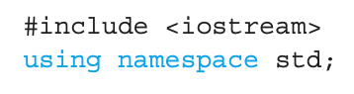
Console Input/Output
Simple console I/O objects: cin, cout, cerr
Defined in the C++ library called <iostream>
Must have the following lines (called pre-processor directives) near start of file:
Tells C++ to use appropriate library so we can use the I/O objects cin, cout, cerr

Slide 55
Separating Lines of Output
New lines in output
‘\n’ is escape sequence for the char "newline"
A second method: object endl
Examples:
cout << "Hello World\n";
Sends string "Hello World" to display, & escape sequence ‘\n’, skipping to next line
cout << "Hello World" << endl;
Same result as above

Slide 56
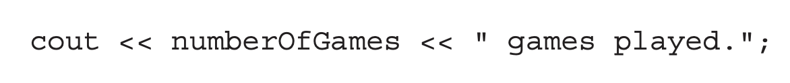
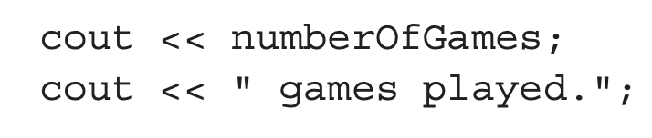
Console Output
What can be outputted?
Any data can be outputted to display screen
Variables
Constants
Literals
Expressions (which can include all of above)
E.g., → 2 values are outputted
"value" of the variable numberOfGames
literal string " games played."
Cascading: multiple values in one cout is allowed
Equivalent to

Slide 57
Input using cin
cin for input, cout for output
Differences:
">>" (extraction operator) points opposite
Think of it as "pointing toward where the data goes"
Object name "cin" used instead of "cout"
No literals allowed for cin
Must input "to a variable"
cin >> num;
Waits on-screen for keyboard entry
Value entered at keyboard is "assigned" to num

Slide 58
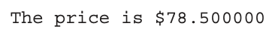
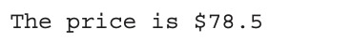
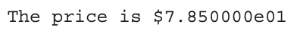
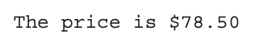
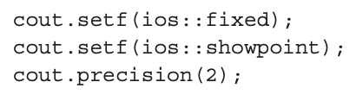
Formatting numbers with decimal point
Consider double price=78.5
Possible outputs:
Ideally, we would want what we can do:
Member function of cout!

Slide 59
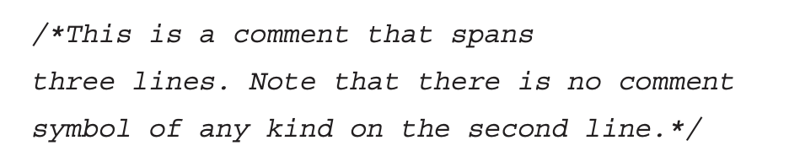
Program Style: Comments
“Just enough” comments are needed
Whenever something is important or not obvious
Too many comments are as bad as too few
Two methods for comments
// Two slashes indicate entire line is to be ignored
/* Delimiters indicates everything between is ignored */

Slide 60
Program Style: Identifier naming
Identifier naming
Must begin with an alphabet character (a-z,A-Z) or underscore (_)
Usually use ALL_CAPS for constants
Most important: Use MEANINGFUL NAMES!

Slide 61
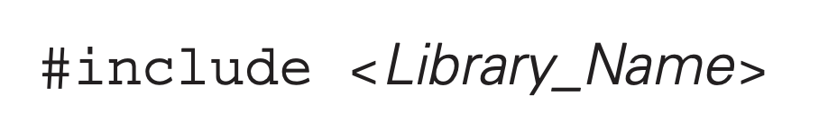
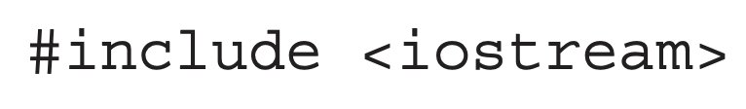
Libraries
C++ Standard Libraries
Directive to "add" contents of library file to your program
Called "preprocessor directive"
Executes before compiler, and simply "copies＂ library file into your program file
C++ has many libraries
Input/output, math, strings, etc.

Slide 62
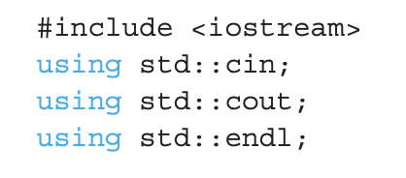
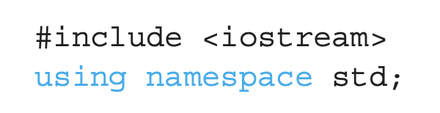
Namespaces
Collection of name definitions
For now, we are only interested in the namespace std
Has all standard library definitions we need
One name can be given different definitions in two namespaces
A simple program that uses console I/O would begin
When you want to use the entire standard library
If only want to use
cin, cout, endl

Slide 63
Summary 1
C++ is a compilation language
Variables, Expressions, Assignments
Case-sensitive
Use meaningful names for variables and constants
Variables must be declared before use (initialize!)
Use care in numeric manipulation
Precision, parentheses, order of operations

Slide 64
Thank you!
Web: http://mindlab-snu.github.io
E-mail: tsmoon@snu.ac.kr

